Slide 1


Presentation
Comparative Analysis and Performance Evaluation of a Two-Wheeled Self-Balancing Robot Using P, PI, and PID Controllers Tuned By Metaheuristic Algorithms
ME 461
Presenters
Control Engineering
S. M. Hasibur Rahman (2010025)
Mostafijur Rahaman (2010101)
Kazi Md. Zareer (2010119)
Md. Arman Hassan (2010155)
Tanzimur Rahman (2010168)
Bangladesh University of Engineering and Technology
Group-05

Slide 2

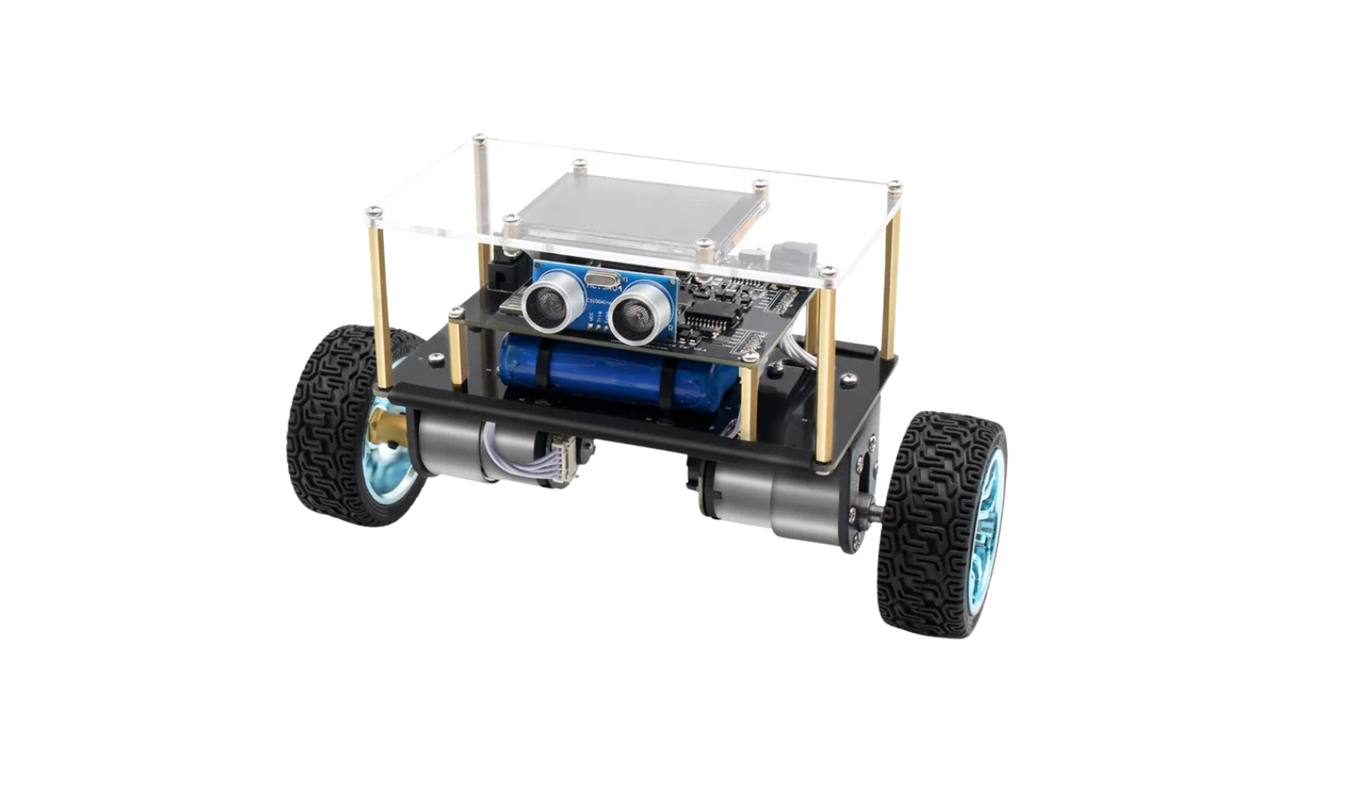
Bangladesh University of Engineering and Technology
Introduction
What is a two-wheeled self-balancing robot?
1. A dynamically unstable mobile system modeled as an inverted pendulum on wheels.
2. Requires continuous feedback control to maintain balance and follow commands.
ME461: Control Engineering

Slide 3


Literature Review
Author Name | Modeling Approach | Control Technique | Trajectory Planning | Hardware Implementation | Linearized Model
Mahler et al. (2013) | Lagrangian + Full Dynamics | Full State Feedback + PI | None | Real Prototype | Yes (State-space from linearized model)
Frankovský et al. (2017) | Lagrangian + Gearmotor | State Feedback (Linear) | None | Simulation only | Yes (Linearized from Lagrangian model)
Le et al. (2024) | Euler–Lagrange + Constraints | HSMC + SMC + Kinematic Controller | RRT-based planning | Simulations (MATLAB) | No (Nonlinear model used)
Halawa et al. (2023) | Basic Transfer Function | PID | None | Physical Robot Built | Simplified Transfer Function
ME461: Control Engineering

Slide 4
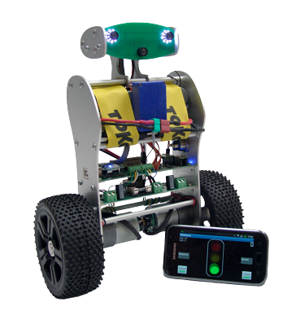
Bangladesh University of Engineering and Technology
Motivation
1. Mahler et al. (2013) developed a mathematical model and control strategy using full-state feedback and PI control.
2. However, their work lacked comparative analysis of simpler PID-based approaches using different controlling algorithms.
ME461: Control Engineering

Slide 5
Bangladesh University of Engineering and Technology
Our Contribution
1. Evaluate P, PI, and PID controllers using metaheuristic algorithms for gain optimization.
2. Assess performance based on transient and steady-state criteria.
3. Provide insights into how intelligent optimization improves classical control.
ME461: Control Engineering

Slide 6
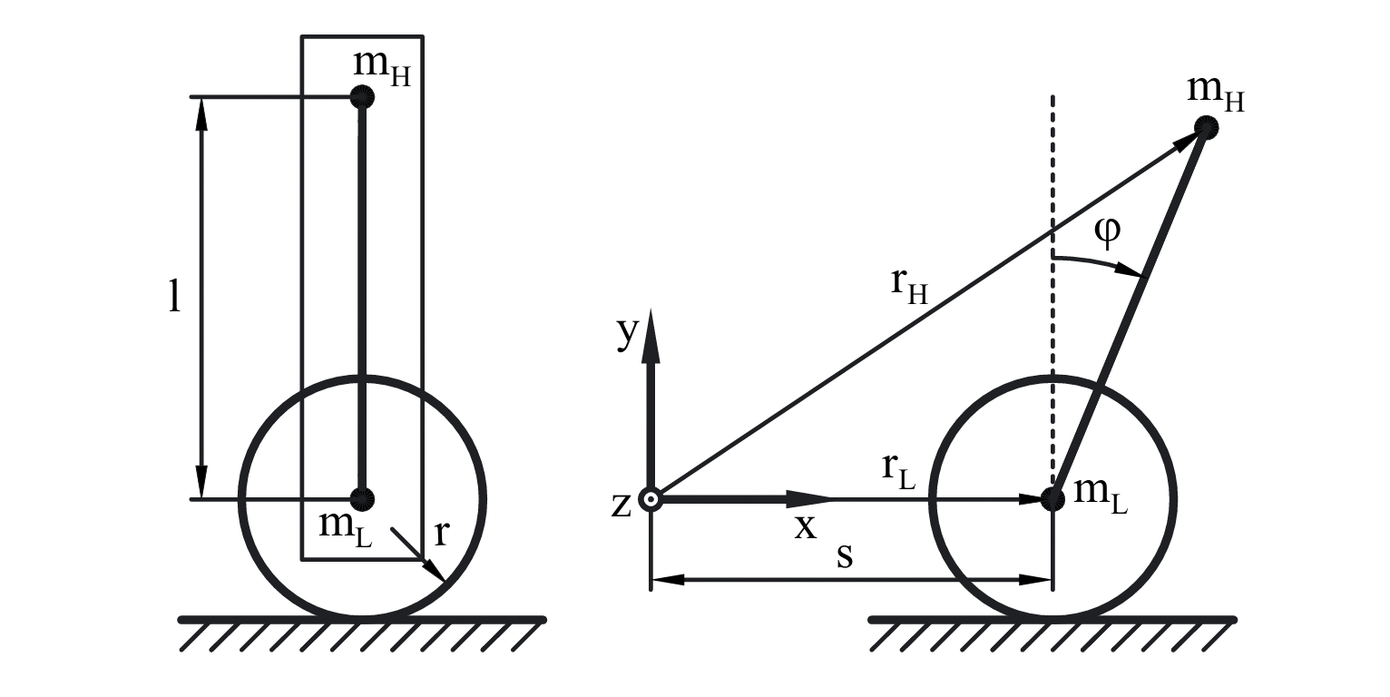
Bangladesh University of Engineering and Technology
Mathematical Modelling
Fig: Structure and definitions of the mathematical model
ME461: Control Engineering

Slide 7
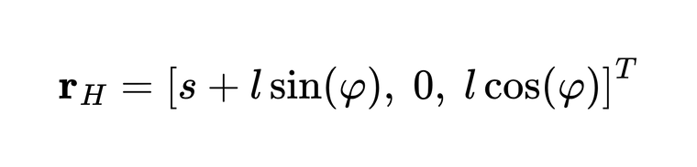
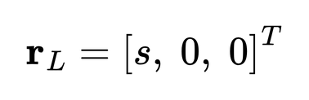
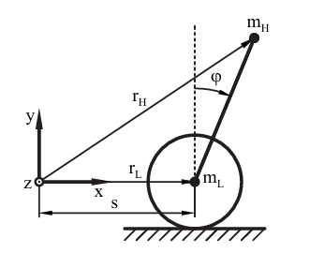


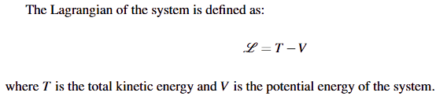
Bangladesh University of Engineering and Technology
Mathematical Modelling
ME461: Control Engineering

Slide 8
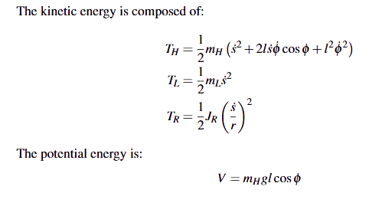
Bangladesh University of Engineering and Technology
Mathematical Modelling
ME461: Control Engineering

Slide 9
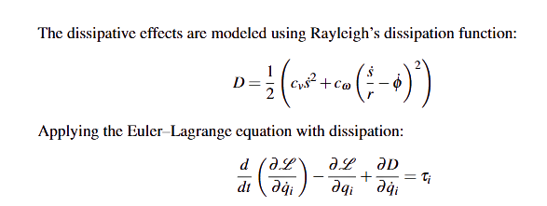
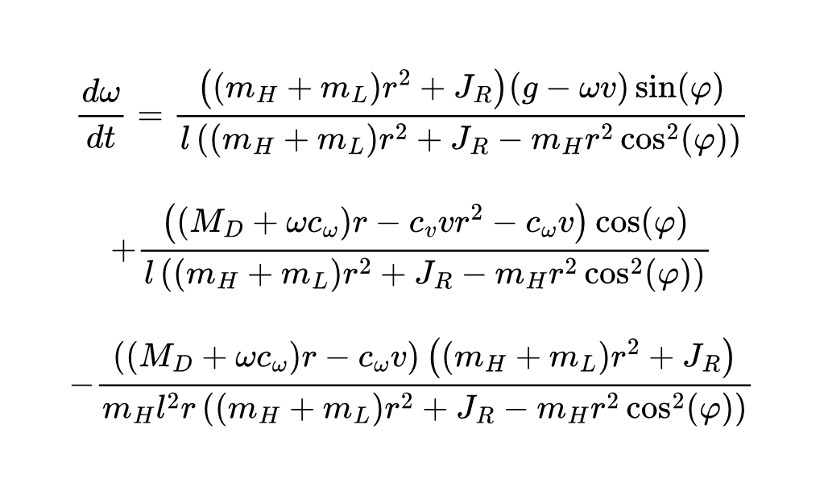
Bangladesh University of Engineering and Technology
Mathematical Modelling
ME461: Control Engineering

Slide 10
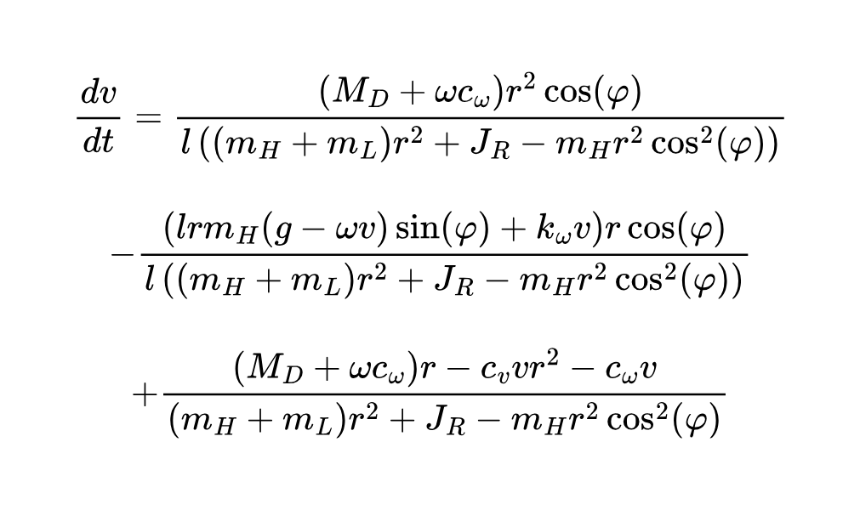
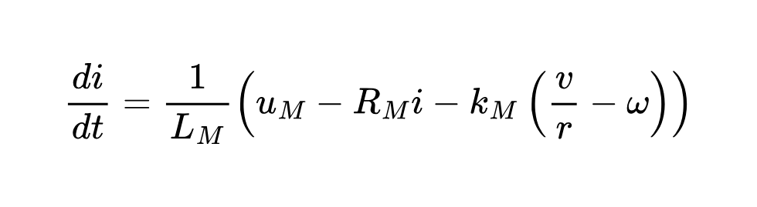
Bangladesh University of Engineering and Technology
Mathematical Modelling
ME461: Control Engineering

Slide 11
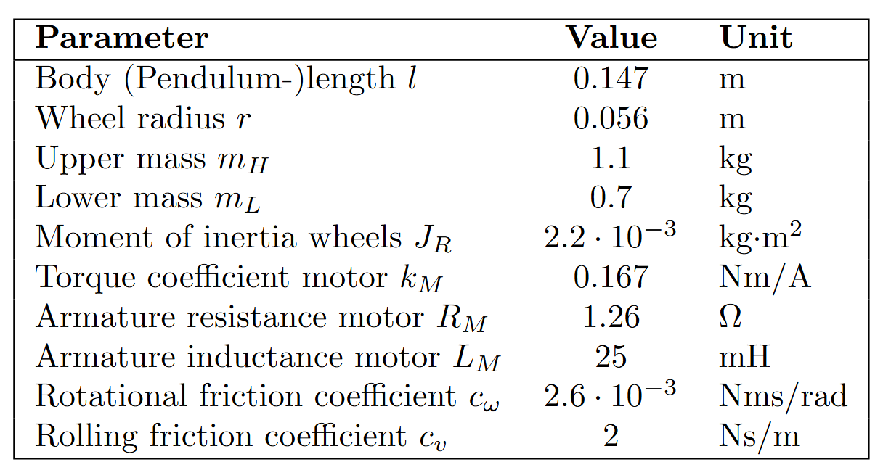
Bangladesh University of Engineering and Technology
Mathematical Modelling
Model parameters of the self-balancing robot
ME461: Control Engineering

Slide 12
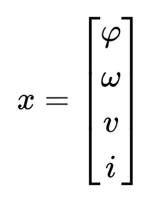
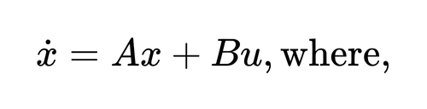
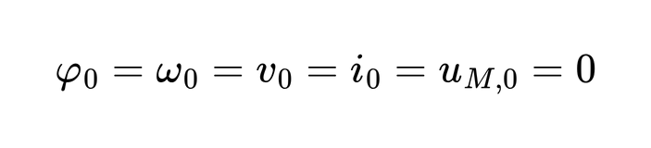
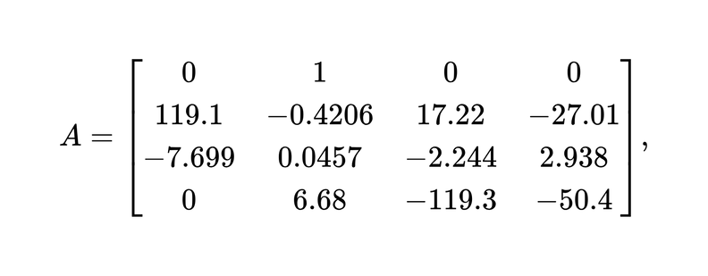
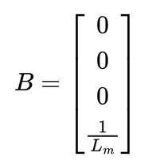
Bangladesh University of Engineering and Technology
Mathematical Modelling
Using jacobian linearization of non linear systems about equilibrium points and taylor expansion of multivariable polynomial and putting the values of the constants, we can write
given that at equilibrium point,
From system parameters we get
ME461: Control Engineering

Slide 13
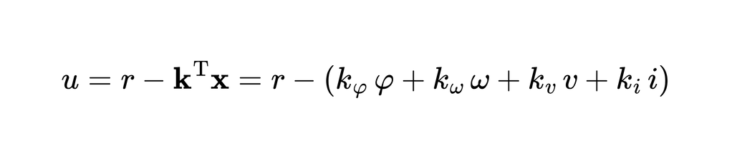
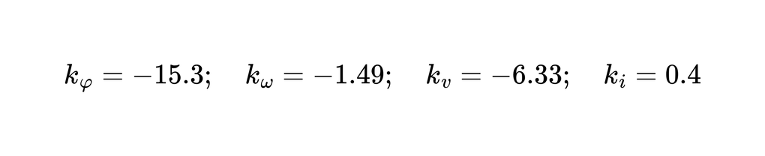
Bangladesh University of Engineering and Technology
Mathematical Modelling
Mahler et al. [1] applied a full-state feedback controller using the linearized state-space model.
The control law is given by:
The feedback gain vector k was calculated using Ackermann’s formula. The resulting gains
were:
ME461: Control Engineering

Slide 14

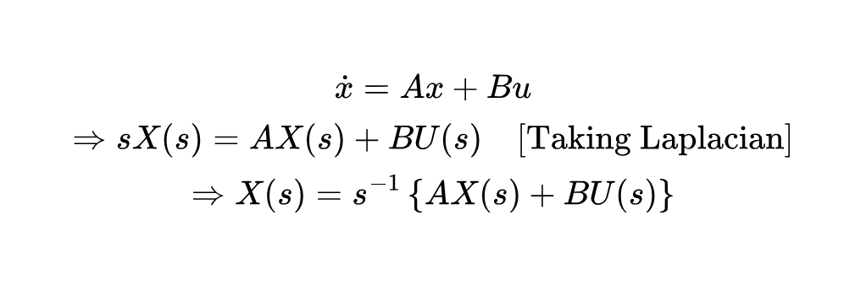
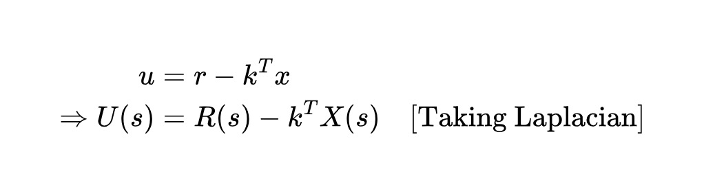
System modelling
(without controller)
Bangladesh University of Engineering and Technology
From linerarized mathematical model,
From full-state feedback controller
22 july 2025
ME461: Control Engineering

Slide 15





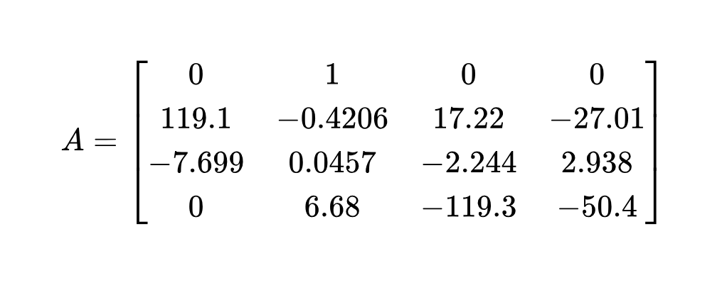
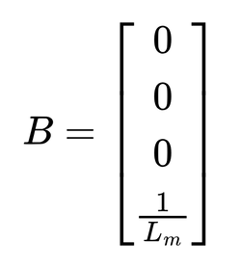
System modelling
(without controller)
Bangladesh University of Engineering and Technology
Block Diagram of the control system without controller:
Vs
u
V
-
S
+
B
+
+
A
Here,
;
;
22 july 2025
ME461: Control Engineering

Slide 16
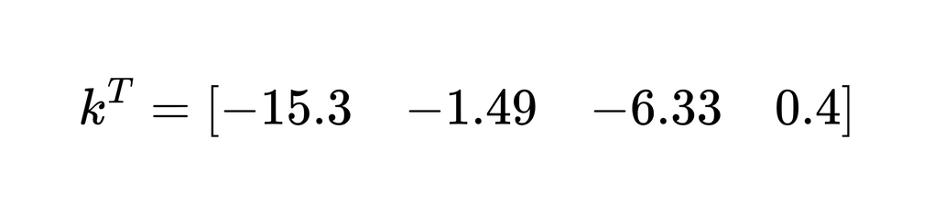
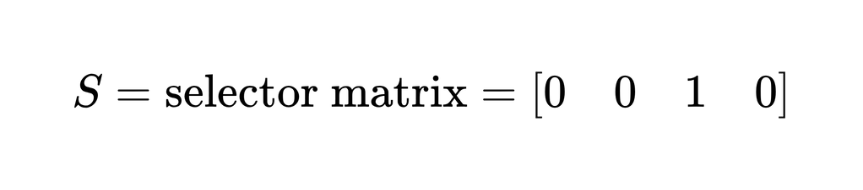
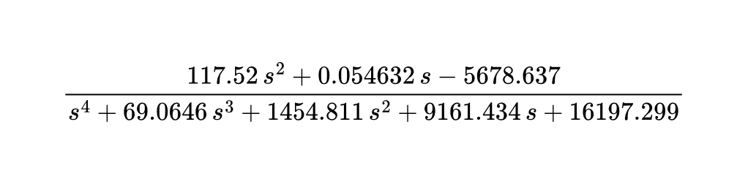
System modelling
(without controller)
Bangladesh University of Engineering and Technology
Reduced block diagram
Vs
V
22 july 2025
ME461: Control Engineering

Slide 17



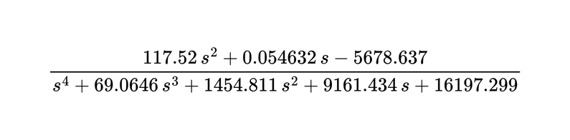
System modelling
(with controller)
Bangladesh University of Engineering and Technology
Vs
e
r
-
u
V
+
-
Controller
+
B
+
+
S
A
reduced block diagram with controller:
Vs
V
+
-
Controller
22 july 2025
ME461: Control Engineering

Slide 18
Bangladesh University of Engineering and Technology
System response and Analysis
(without controller)
  Stability Analysis
  Steady State Error Analysis
  System response for Unit Step Input , Ramp Input, Parabolic Input, Sinusoidal Input
  Bode Plot
  Polar Plot
ME461: Control Engineering

Slide 19
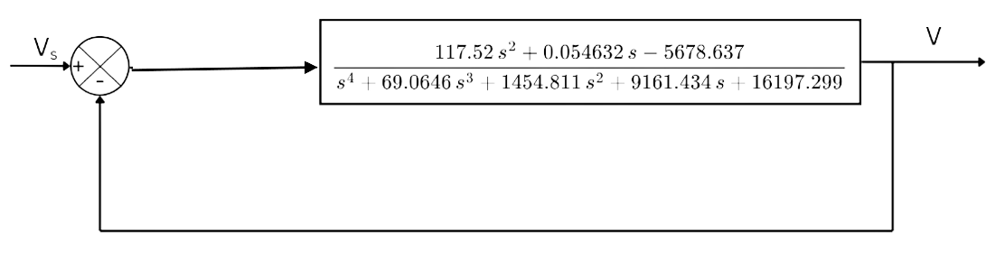
Stability Analysis
( without Controller)
Bangladesh University of Engineering and Technology
Block Diagram of the system (without Controller) :
117.52 S2 + 0.054632 S -5678.637
Hear, G(s) =
S4 + 69.0646 S3 + 1454.811 S2 +9161.434S +16197.299

Slide 20
Stability Analysis
( without Controller)
Bangladesh University of Engineering and Technology
Closed Loop Transfer Function :
117.52 S2 + 0.054632 S -5678.637
Gₑ(s) =
S4 +69.0646S3 +1572.331S2 +1961.488S +10518.662
The characteristics equation will be :
S4 +69.0646S3 +1572.331S2 +1961.488S +10518.662 =0

Slide 21
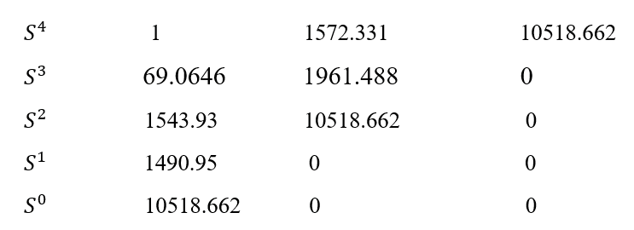
Stability Analysis
(without Controller)
Bangladesh University of Engineering and Technology
Routh Table
There is no sign change at this table. So, the system is stable

Slide 22
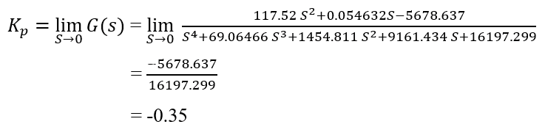

Steady State Error Analysis
(without Controller)
Bangladesh University of Engineering and Technology
  For Unit Step Input :

Slide 23
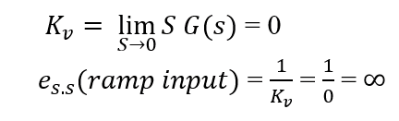
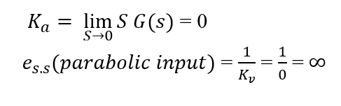
Steady State Error Analysis
(without Controller)
Bangladesh University of Engineering and Technology
  For Ramp Input :
  For Parabolic Input :

Slide 24
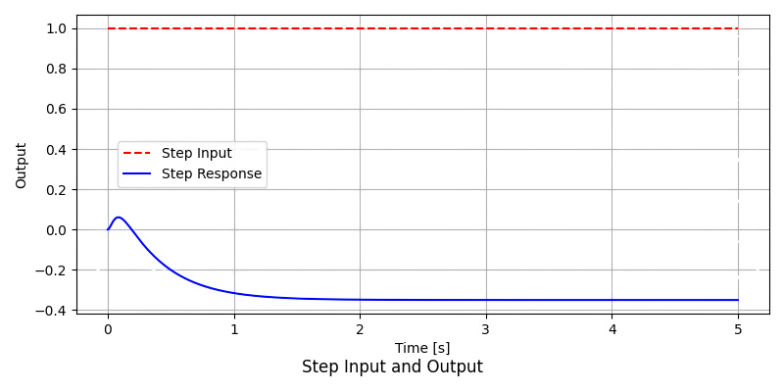
System Responses
(without Controller)
Bangladesh University of Engineering and Technology
Unit Step Input

Slide 25
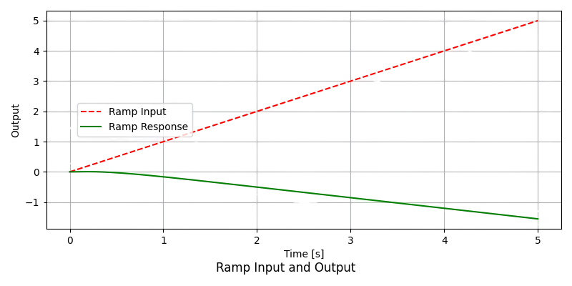
System Responses
(without Controller)
Bangladesh University of Engineering and Technology
Ramp Input

Slide 26
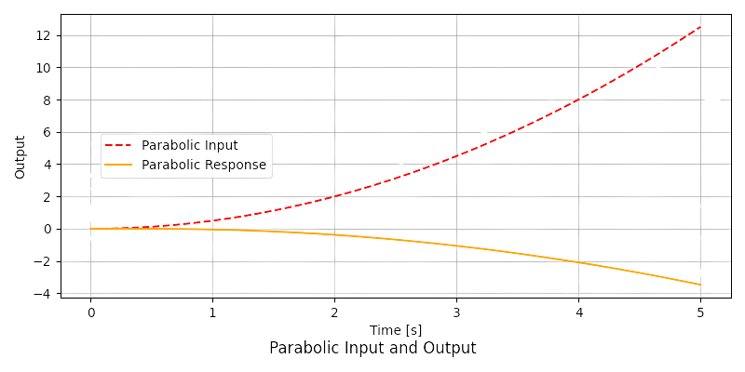
System Responses
(without Controller)
Bangladesh University of Engineering and Technology
Parabolic Input

Slide 27
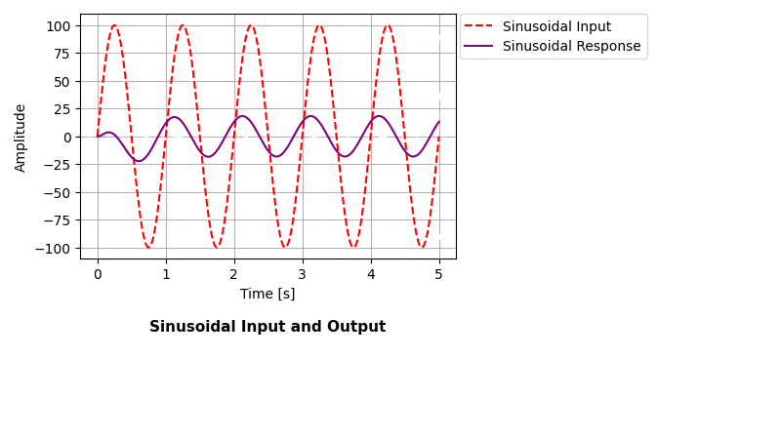
System Responses
(without Controller)
Bangladesh University of Engineering and Technology
Sinusoidal Input

Slide 28
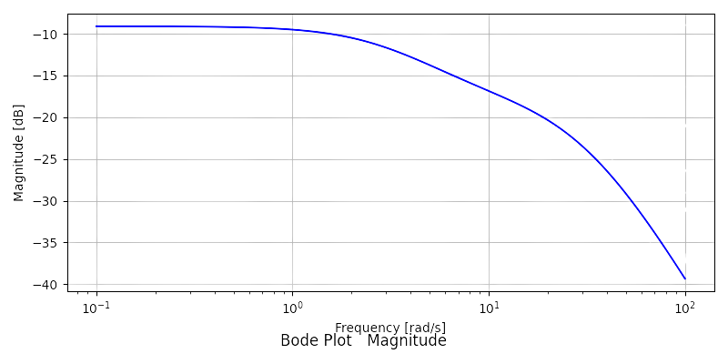
Bode Plot
(without Controller)
Bangladesh University of Engineering and Technology
Magnitude

Slide 29
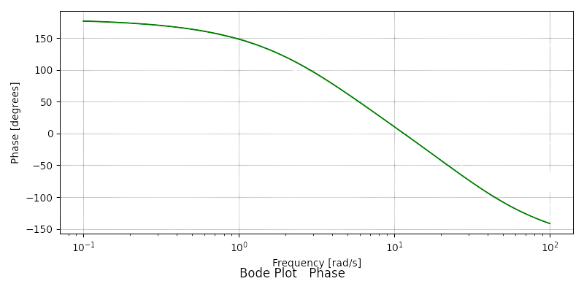
Bode Plot
(without Controller)
Bangladesh University of Engineering and Technology
Phase

Slide 30
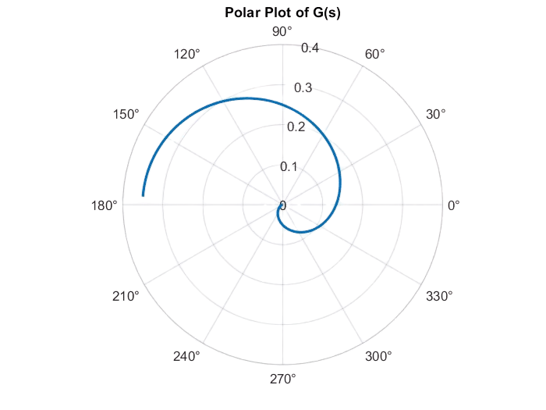
Polar Plot
(without Controller)
Bangladesh University of Engineering and Technology

Slide 31

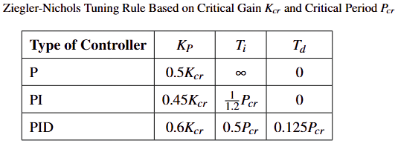


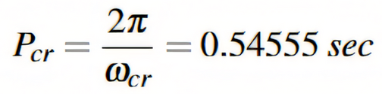
PID Tuning
Bangladesh University of Engineering and Technology
Using Ziegler–Nichols tuning rules

Slide 32
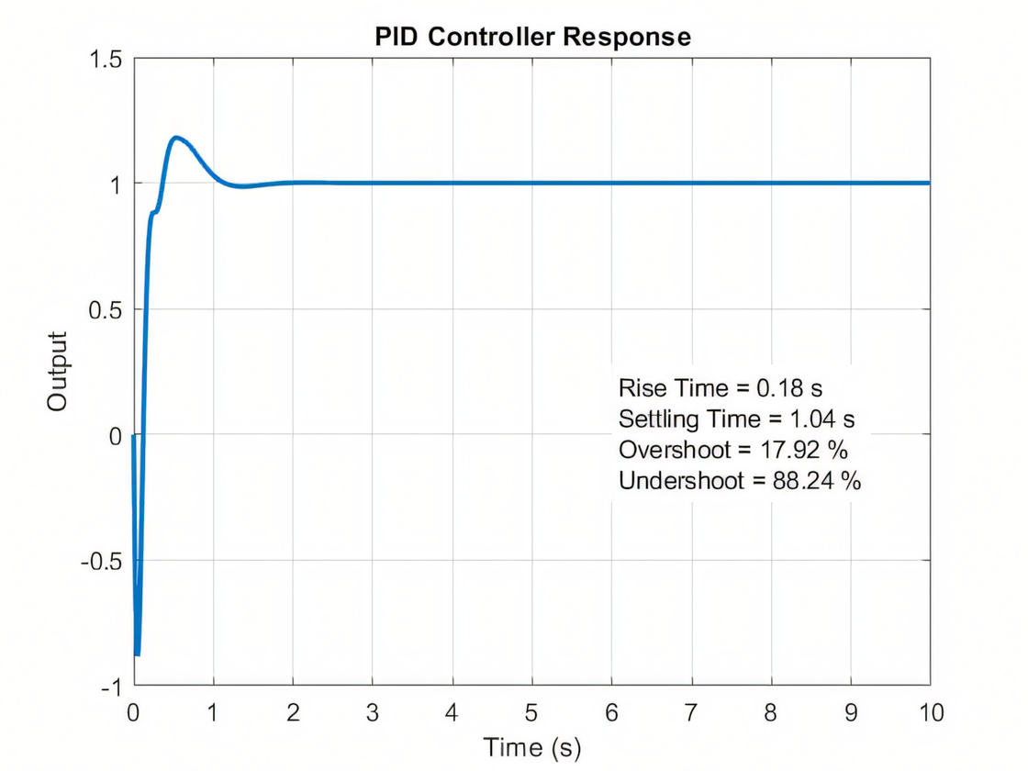
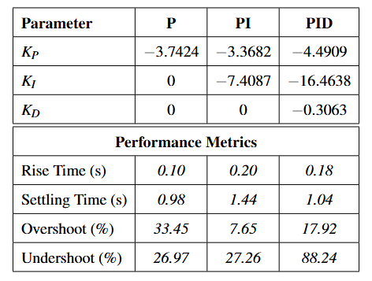
PID Tuning Results
Using Ziegler–Nichols tuning rules
Bangladesh University of Engineering and Technology

Slide 33
Summary of Recent Research using different algorithms
Paper Reference | PID Tuning Algorithm Used | Comments and Findings
Kumar et al. (2012) - "Tuning of PID Controller of Inverted Pendulum Using Genetic Algorithm" | Genetic Algorithm (GA) | Similar to our work as it uses GA-based PID tuning on an inverted pendulum system, which is analogous to a two-wheeled self-balancing robot.
Olmez et al. (2022) - "Clonal selection algorithm-based control for two-wheeled self-balancing mobile robot" | Clonal Selection Algorithm (CSA), PSO, ABC, DE, GoldSa-II, Cuckoo Search | Directly relevant as it involves a two-wheeled self-balancing robot and demonstrates the comparative effectiveness of metaheuristic optimization methods for PID tuning.
Hassanzadeh & Mobayen (2011) - "Controller Design for Rotary Inverted Pendulum System Using Evolutionary Algorithms" | GA, PSO, ACO | Relevant as it tests multiple PID tuning methods, giving insights into algorithm effectiveness for balancing tasks similar to our two-wheeled robot scenario.
Yetayew & Tesfaye (2024) - "A Comparative Analysis of Metaheuristic Algorithms Tuned Supper Twisting Sliding Mode Control of a Self-balancing Segway" | GWO, GA, PSO | Highly relevant; directly involves a two-wheeled self-balancing Segway system and compares multiple PID tuning algorithms, closely aligned with our project's goals.

Slide 34
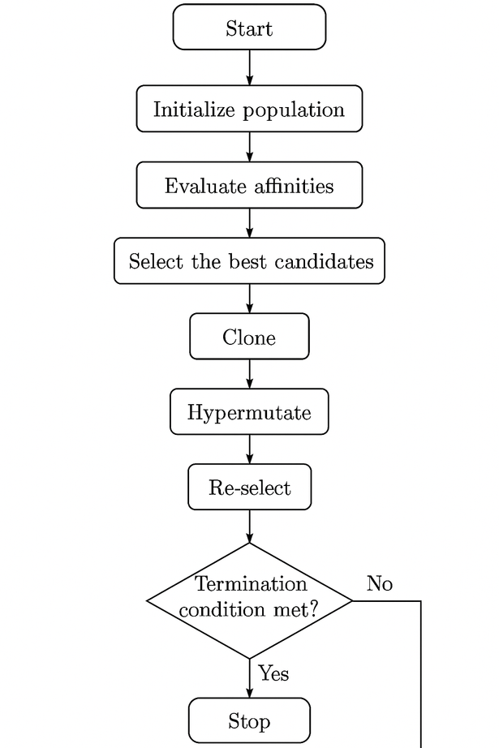
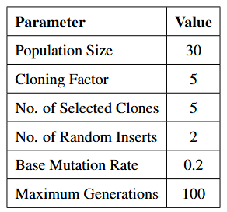


PID Tuning
Bangladesh University of Engineering and Technology
Using CSA (Clonal Selection Algorithm)

Slide 35
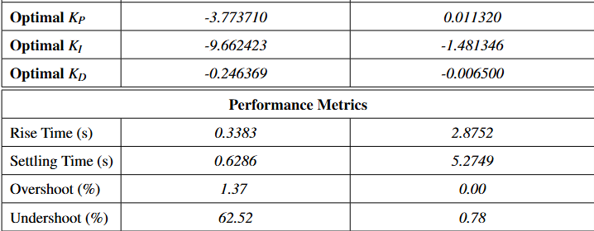
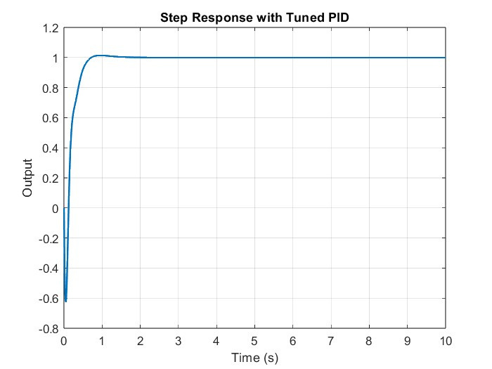
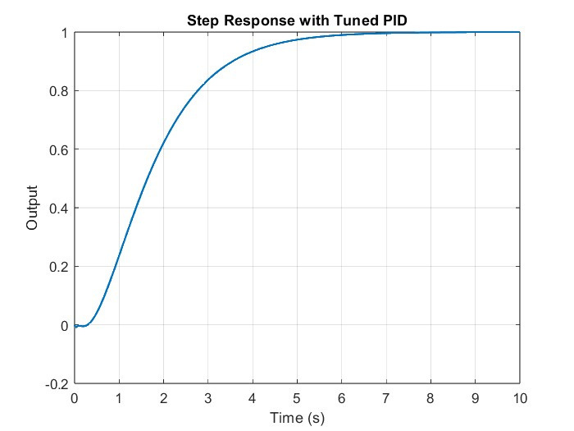
PID Tuning Results
Using CSA (Clonal Selection Algorithm)
Step response with Tuned PID controller
Allowing undershoot
Penalized Undershoot with cost function

Slide 36
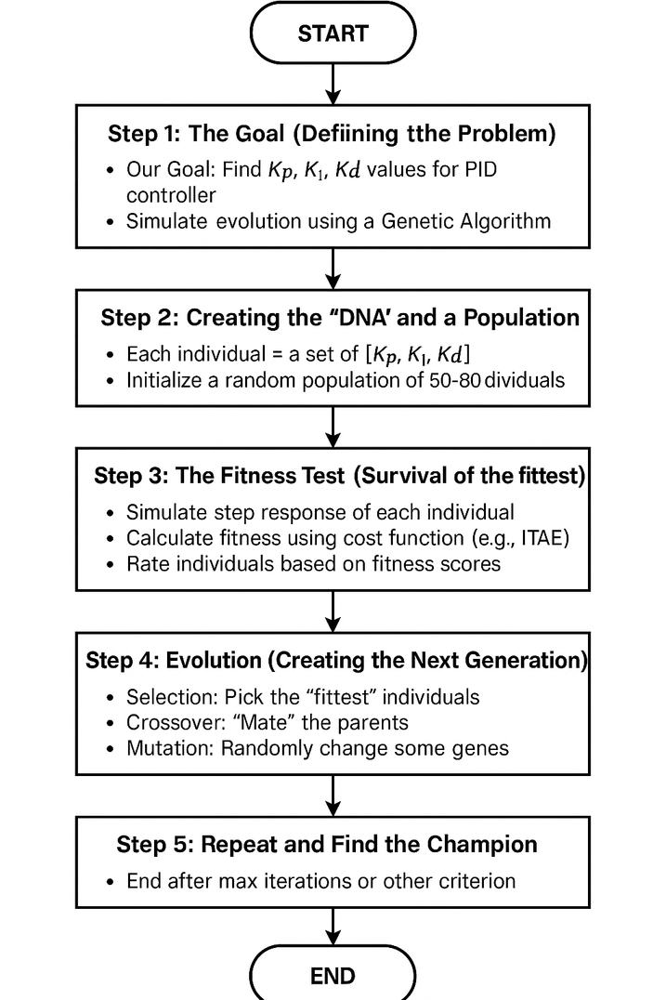

Genetic Algorithm
Parameters and Values
Cost Function
Bangladesh University of Engineering and Technology

Slide 37



PID Tuning Results
Using GA (Genetic Algorithm)
Step response with Tuned PID controller
Penalized Undershoot with cost function
Allowing undershoot

Slide 38


PID Tuning Results
Using MATLAB Auto-Tuner Software
Bangladesh University of Engineering and Technology

Slide 39


Comparison of Controllers
Without Undershoot Penalization

Slide 40


Comparison of Controllers
With Undershoot Penalization

Slide 41

Conclusion
  PID controllers offered the best overall performance
  Ziegler Nichols tuning produced fast responses but resulted in large overshoot and undershoot
  MATLAB’s auto tuner provided acceptable PI and PID responses but lacked fine tuning capabilities
  Metaheuristic tuning with GA and CSA enabled precise control, with undershoot penalization improving stability and accuracy.
5.Genetic Algorithm achieved the best penalized result with lowest undershoot and faster settling, outperforming CSA.

Slide 42
Reference
[1] B. Mahler, J. Haase, Balancing an inverted pendulum on a mobile robot, in: 2013 19th International
Conference on Automation and Computing (ICAC), IEEE, 2013, pp. 1–6. doi:10.1109/IConAC.2015.7313975.
[2] P. Frankovsk´y, L. Dominik, A. Gmiterko, I. Virgala, P. Kuryło, O. Perminova, Modeling oftwo-wheeled self-
balancing robot driven by dc gearmotors, International Journal of AppliedMechanics and Engineering
22 (3) (2017) 739–747. doi:10.1515/ijame-2017-0046.
[3] H. N. Le, M.-K. Pham, D.-H. Pham, T.-V.-A. Nguyen, Trajectory tracking and stabilization of two-wheeled balancing mobile
robot with hierarchical and sliding mode control, InternationalJournal of Dynamics and Control (2024).
doi:10.1007/s40435-024-01518-0.
[4] O. Halawa, et al., Mechatronics project: Two-wheeled self-balancing robot, unpublished technical report, Department of Mechatronics Engineering, Helwan University (2023).
[5] P. Kumar, O. N. Mehrotra, J. Mahto, Tuning of pid controller of inverted pendulum using genetic algorithm, International Journal of Research in Engineering and Technology (IJRET) 1 (3) (2012) 359–363.
[6] Y. Olmez, G. O. Koca, Z. H. Akpolat, Clonal selection algorithm-based control for two-wheeled self-balancing mobile robot, Simulation Modelling Practice and Theory 118 (2022) 102550. doi:10.1016/j.simpat.2022.102550.
[7] I. Hassanzadeh, S. Mobayen, Controller design for rotary inverted pendulum system using evolutionary algorithms, Mathematical Problems in Engineering 2011 (2011) Article ID 572424.doi:10.1155/2011/572424.
[8] B. Yetayew, D. Tesfaye, A comparative analysis of metaheuristic algorithms tuned super twist-
ing sliding mode control of a self-balancing segway, Engineering Science and Technology, an
International JournalAccepted/In press (2024).

Slide 43
Bangladesh University of Engineering and Technology
Thank You
ME 461
Control Engineering
27 July 2025

